Slide 1

Week #11,#12
AI Academy®
1
Day 1, 2, 3:
Laravel Rest API’s
Final Project Evaluation
Final Term Exam
Reviews & Feedbacks

Slide 2

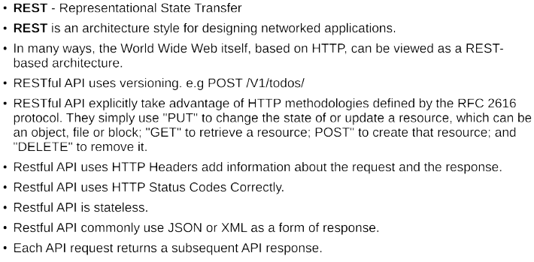
Week #11,#12
AI Academy®
2

Slide 3
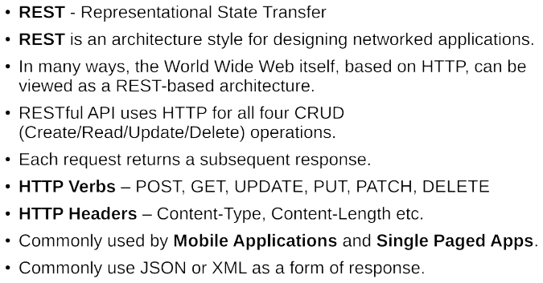
Week #11,#12
AI Academy®
3

Slide 4
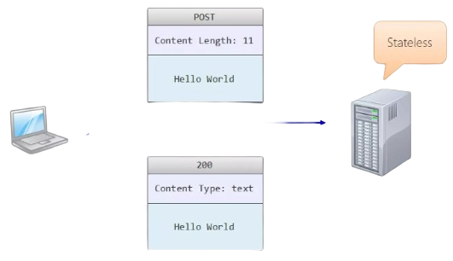

Week #11,#12
AI Academy®
4

Slide 5
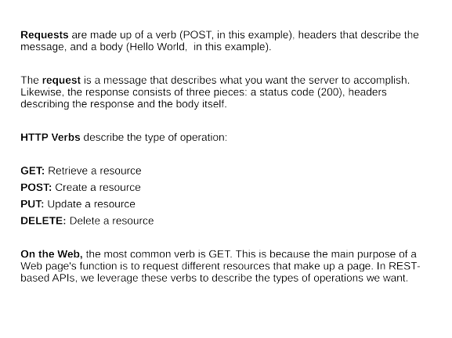
Week #11,#12
AI Academy®
5

Slide 6
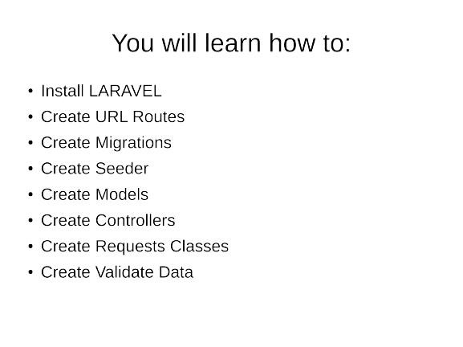
Week #11,#12
AI Academy®
6

Slide 7

Week #11,#12
AI Academy®
7
See the Exercise Off
Laravel CRUD Application
On GitHub @theaamirlatif

Slide 8
Week #11,#12
AI Academy®
8
Day 4, 5:
Final Term Exam

